Slide 1

Suicide in the United States
Facts, Figures, and Formulas for Prevention

Slide 2
In this presentation, we will analyze:
Differences in Suicide Among Men and Women? (Kasia)
Relationship between Gun Vendors and Gun Mortalities (Chandra)
Differences in Suicide Among Ages (Hussain)
Teen Suicide in Washington D.C. (Johar)
Suicide Growth over the Years (Manny)

Slide 3
Differences in Suicide Among Men and Women

Slide 4
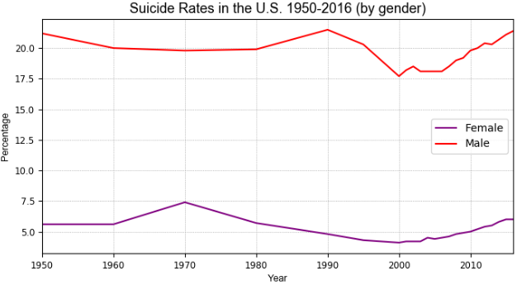
Differences in Suicide Among Men and Women
Source: US Department of Health and Human Services; CDC (September, 2018). Deaths by suicide per 100,000 resident population in the United States from 1950 to 2016, by gender.

Slide 5
Analysis of Differences in Suicide Among Men and Women
On average, men died by suicide 3x more often than women (20% for males and 5% for females)
There are a number of gender differences in suicide. This is known as the gender paradox of suicide. While females are more likely to experience suicidal thoughts, males are more likely to take their own lives. This may be due to differences in gender roles and expectations
In 1990 and 2016, men had the highest suicide rates (21.5% and 21.4% per 100,000) among males
In 1970 and 2016, women had the highest suicide rate (7.4% and 6% per 100,000) among females

Slide 6
II. Relationship between Gun Vendors and Gun Mortalities

Slide 7
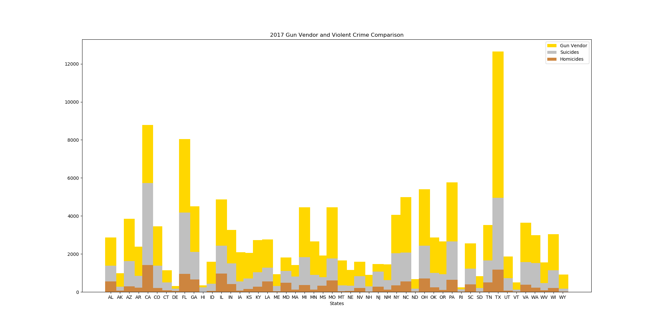
v
v
Relationship Between
Gun Vendors and Violent Crime
2017

Slide 8
Gun Deaths in America
Many people believe that the availability of guns and suicides are closely related.
We can see the highest suicide to vendor ratio in the Northern Plains and the more rural areas of the United States.
In just ten years the suicide rate for Native American Women has jumped up 139%, and Men 71%
As states become more dense, the suicide rate also tends to go down. Greater awareness?
Cities often closely regulate gun sales to try to slow violent crime related deaths.
In 2017 suicides accounted for 6 out of 10 gun deaths! However, due to respect for the deceased, suicides often go unreported.
Though it may seem like gun vendors have a strong influence on violent death in America, it must be taken into consideration that there are many other factors that make up the complexity of this problem

Slide 9

Where do we go from here?
Isolation has also been a key factor in suicide. So has addiction. With our modern world of connectivity, are we able to detect and combat regional / social isolation? Link people that need to be connected. Using Tweepy to sentiment analysis would we be able to catch the warning signs?
Interactive heat maps. Heightened public knowledge increases awareness! Would we be able to map emotions after a natural disasters? See what impacts the communities around us. Is it possible to map out what causes unhappiness?

Slide 10
III. Differences in Suicide Among Ages

Slide 11
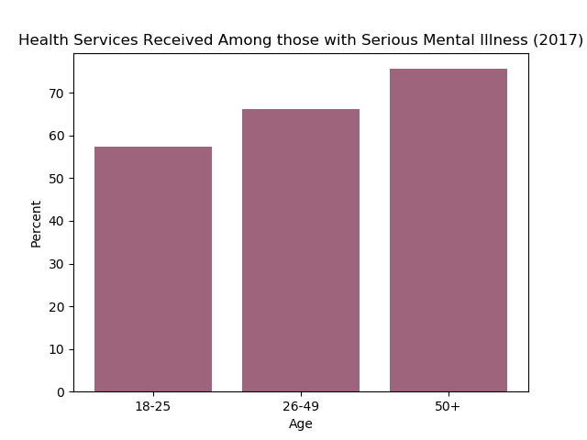
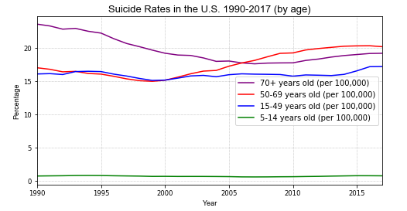
The percentages of adults with SMI aged 26-49 years (66.2%) and aged 50 and older (75.6%) with SMI who received mental health treatment were higher than young adults with SMI aged 18-25 years (57.4%).

Slide 12
Future Data
NIH defines mental health services as having received:
-inpatient/outpatient treatment
-counseling
-prescription medication
Mental health is a key factor when it comes to suicide.
Will future data help us in analyzing the effectiveness of our methods in preventing suicide?
Geospatial analysis to determine availability of services to underserved populations
-Rural areas
-Montana has the highest suicide rate in the US

Slide 13


Code

Slide 14
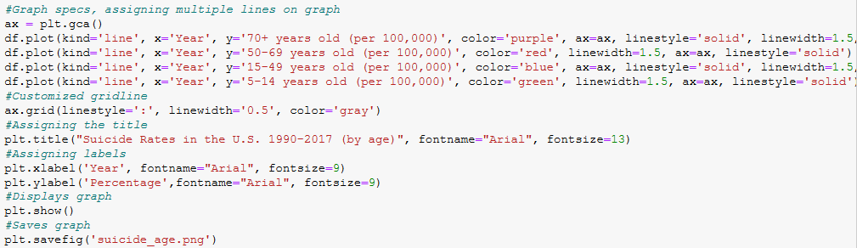
Code continued

Slide 15
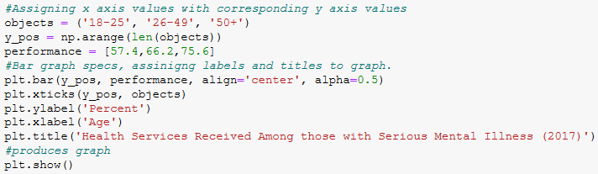
Final code

Slide 16
IV. Teens who have Attempted to commit Suicide in Washington, D.C.
Facts, Figures and Trends (2005 -2017)

Slide 17
Facts
Suicide among young people continues to be a serious problem in the United States. Suicide is the third leading cause of death in people between the ages of 15 and 24 and the overall eleventh leading cause of death in the United States.
Males are four times more likely to die from suicide than females, but females are more likely to attempt suicide. In addition to deaths by suicide, there are an estimated 16 attempted suicides for every suicide committed.
Research shows that most people who commit suicide have a diagnosable mental illness or substance abuse disorder.
Studies show that addressing psychiatric illness through early recognition, intervention, and treatment is an effective way to combat suicidal behavior.
Reference:
Matters, D. C. H. (n.d.). Teens who have Attempted Suicide. Retrieved November 2, 2019, from http://www.dchealthmatters.org/?module=indicators&controller=index&action=view&comparisonId=&indicatorId=1048&localeId=130951&localeChartIdxs=1|2|3|4.

Slide 18
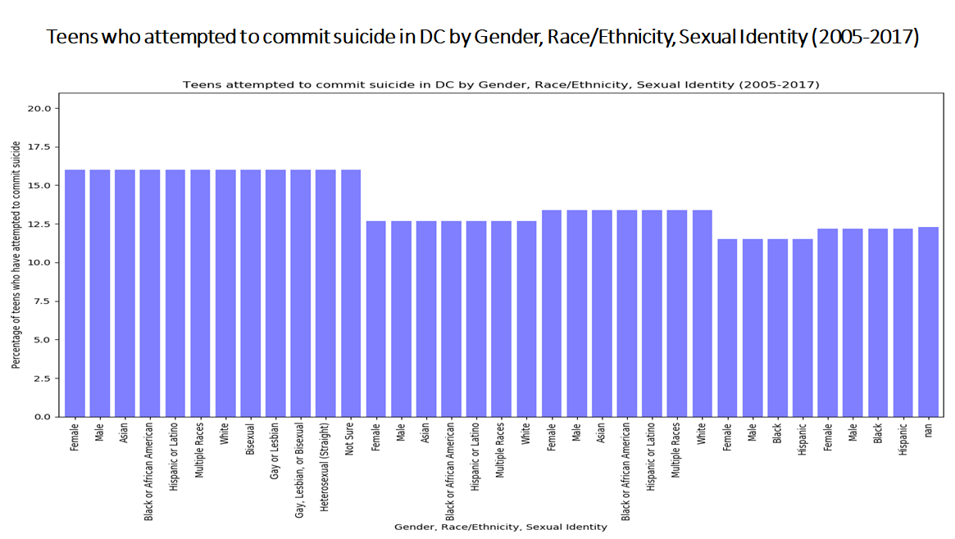
Bar chart

Slide 19
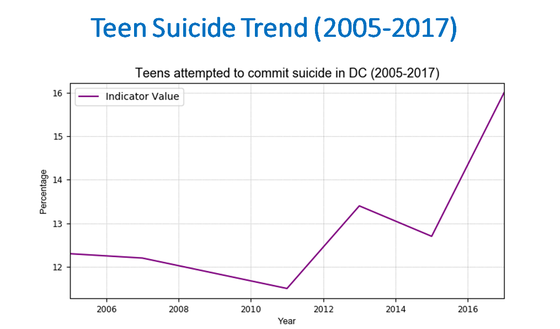

Slide 20
Strategy
Search for an informative CSV file from an authentic data source.
Problems
Changing the data type in the CSV file for a column of Period of Measure to avoid mathematical calculation and to present an accurate trend as the numpy was adding the year column.
Learned
Learned how to create and configure Bar Chart and Line graphs for easy readability.

Slide 21
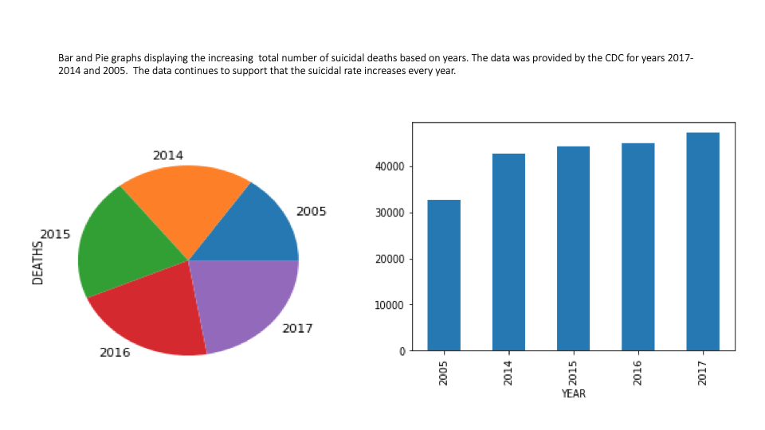

Slide 22
V. Suicide Growth over the Years

Slide 23
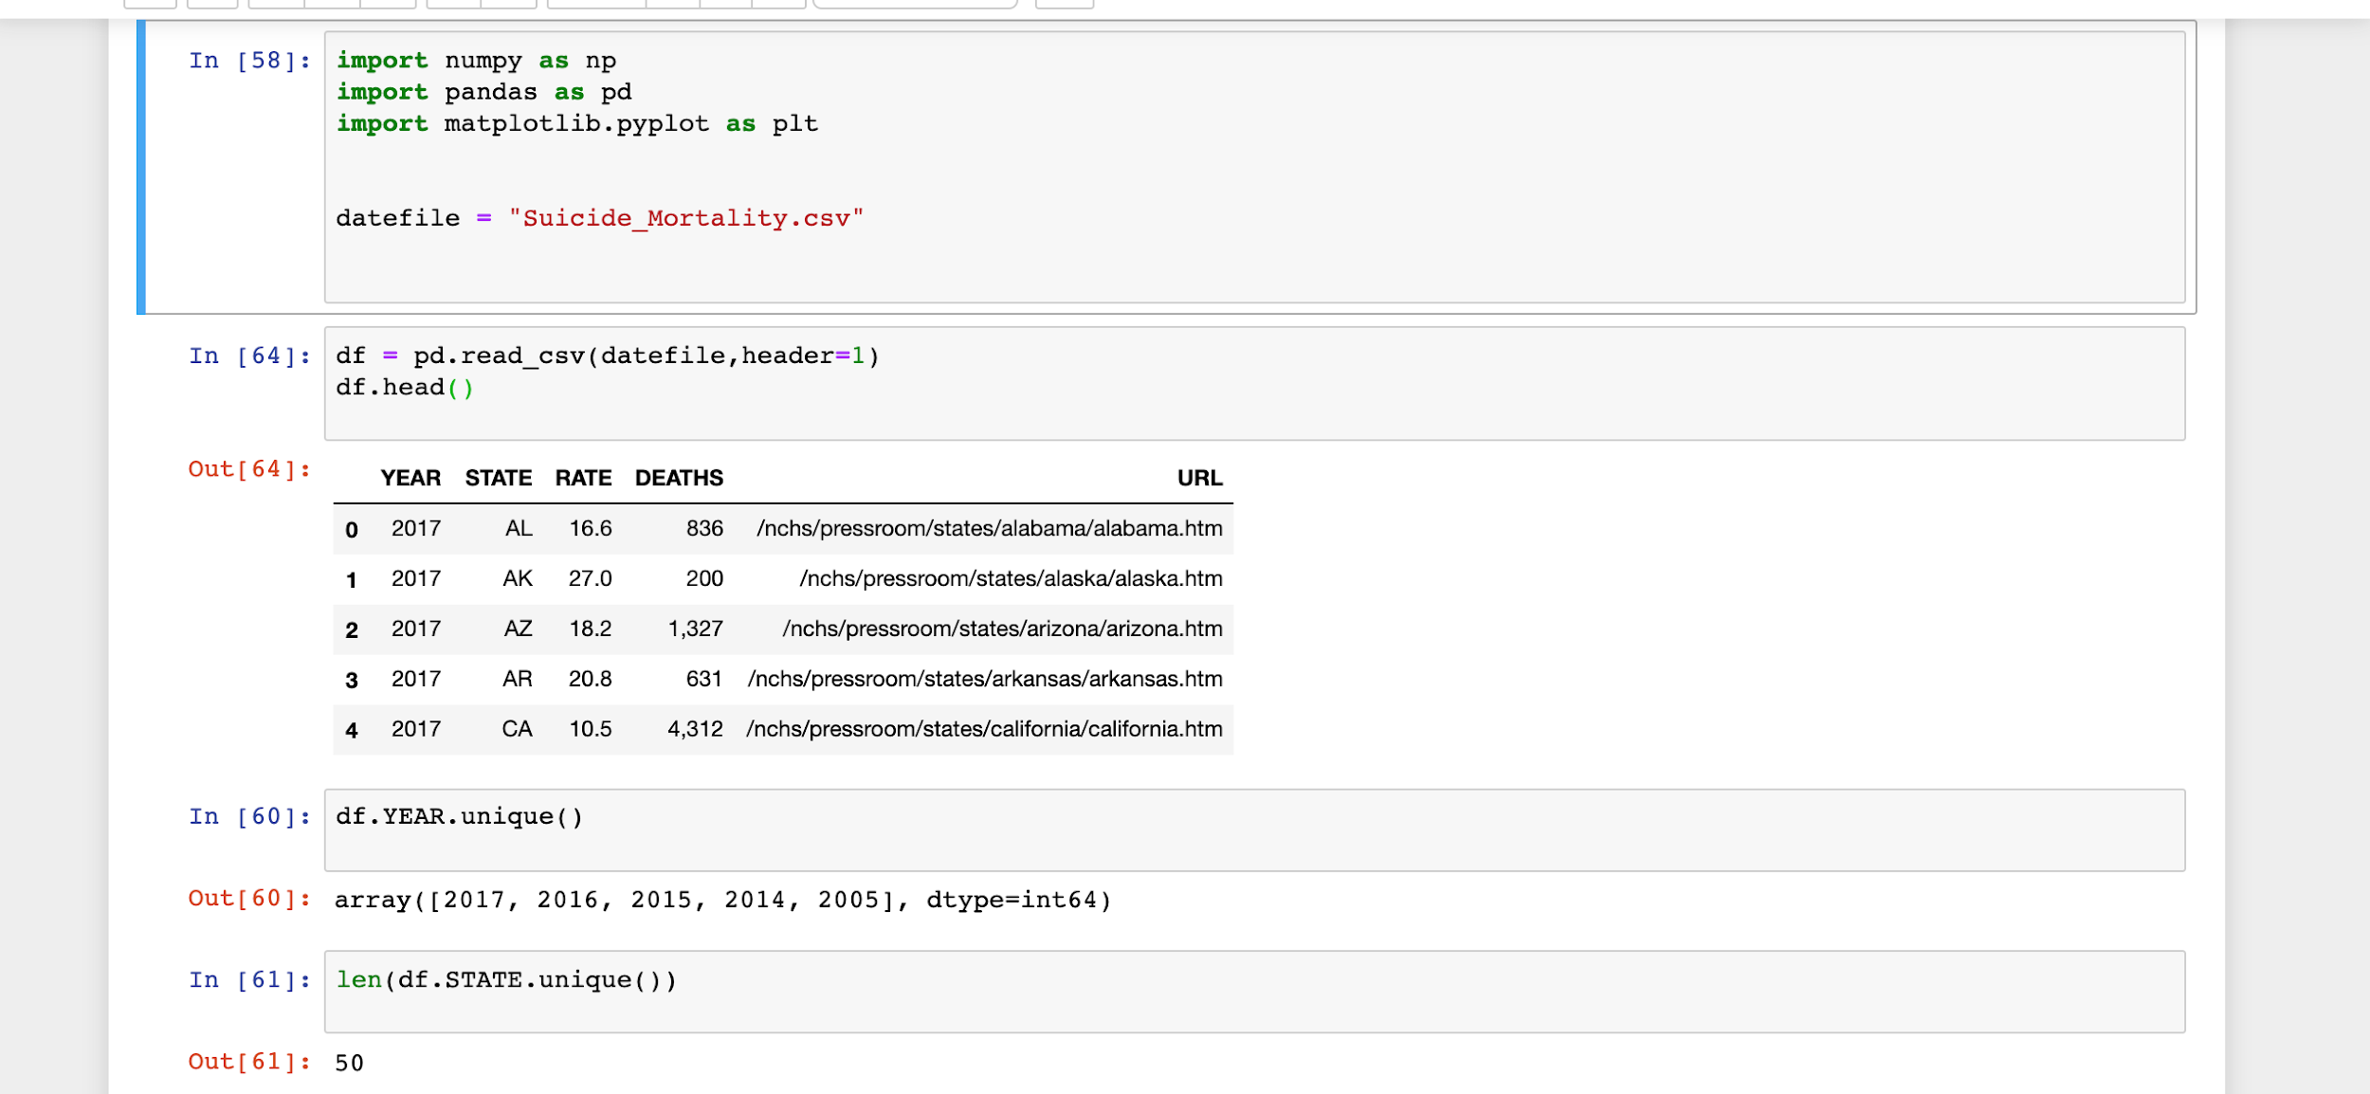

Slide 24
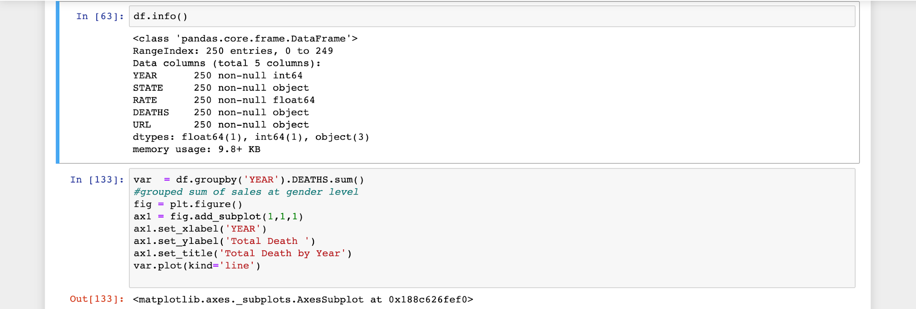

Slide 25
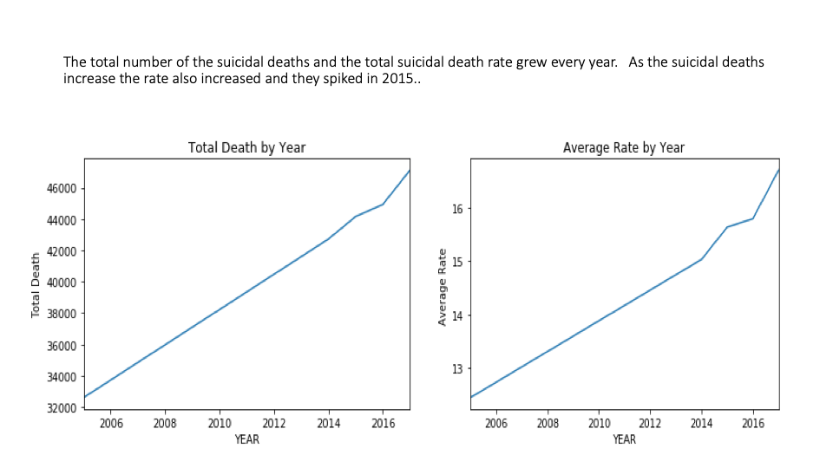

Slide 26
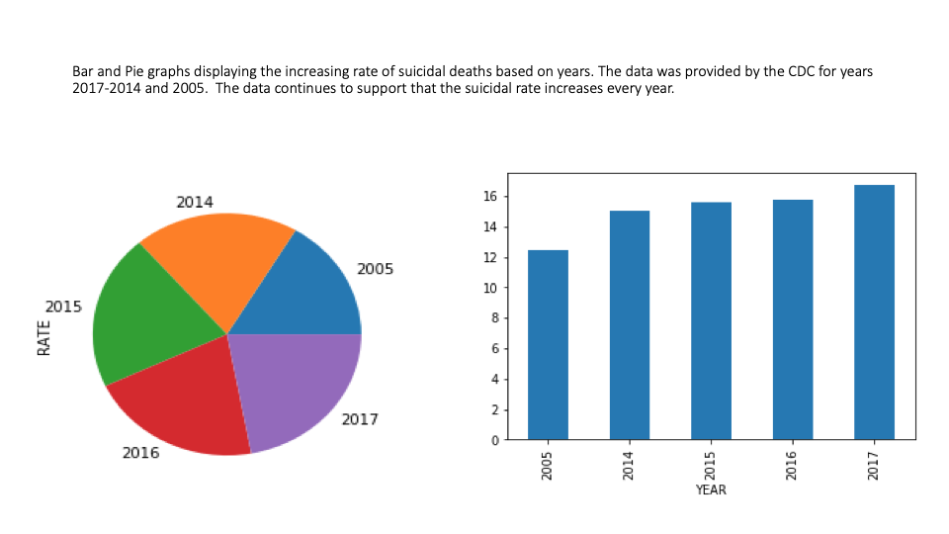

Slide 27
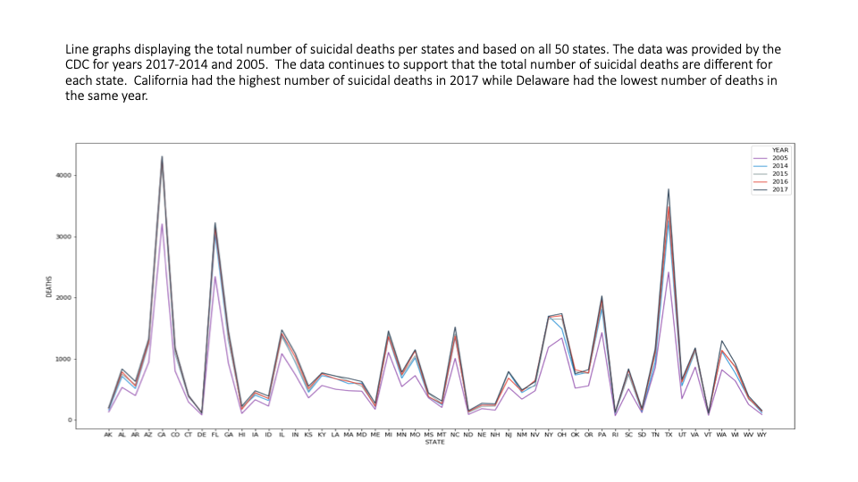

Slide 28
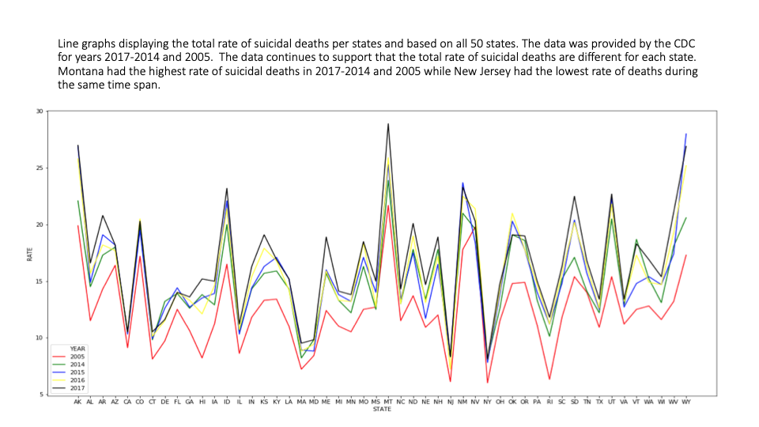

Slide 29
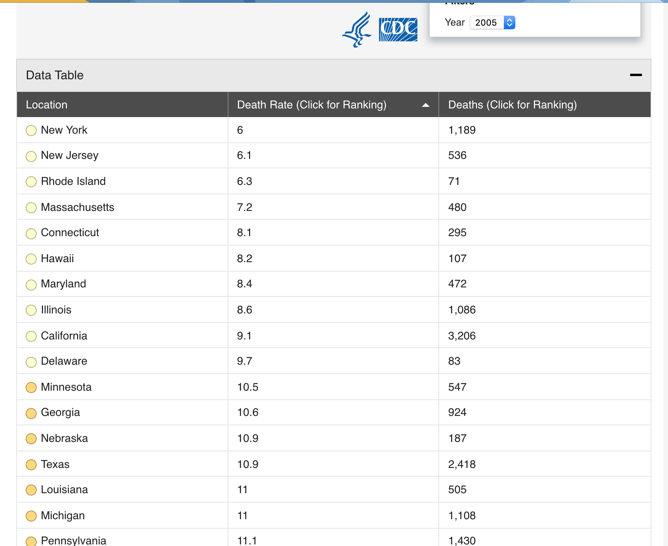

Slide 30
National Suicide Hotline Phone Number
Call 1-800-273-8255

Slide 31


Slide 32
Sources: Gun Deaths in America
Mortality Data is from the CDC’s Multiple Cause of Death datafile.
https://www.cdc.gov/nchs/data_access/VitalStatsOnline.htm#Mortality_Multiple
Firearm Data is from The Bureau of Alcohol, Tobacco, Firearms, and explosives
https://www.atf.gov/firearms/listing-federal-firearms-licensees-ffls-2017

Slide 33
Sources: Suicide Rate vs. Age
https://www.nimh.nih.gov/health/statistics/mental-illness.shtml
https://ourworldindata.org/grapher/suicide-death-rate-by-age?country=USA

Slide 34
Sources:
Stats of the State - Suicide Mortality. Centers for Disease Control and Prevention (Jan. 10, 2019).
https://www.cdc.gov/nchs/pressroom/sosmap/suicide-mortality/suicide.htm

